Slide 1
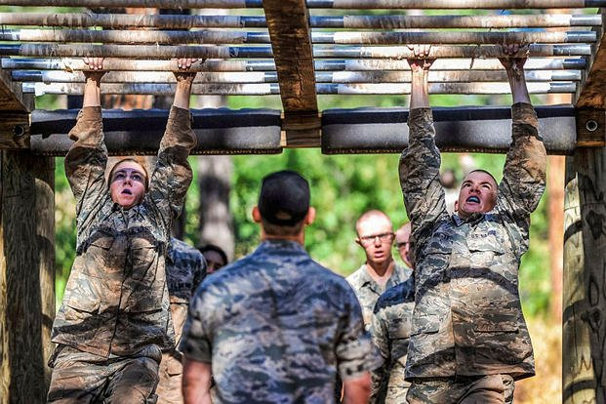
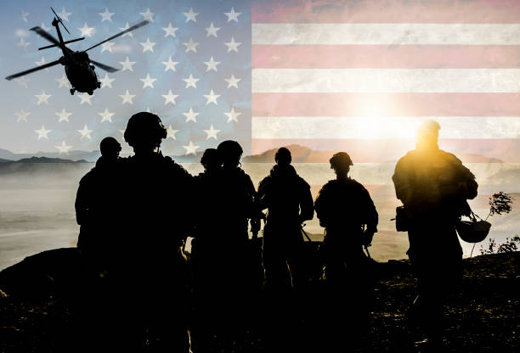
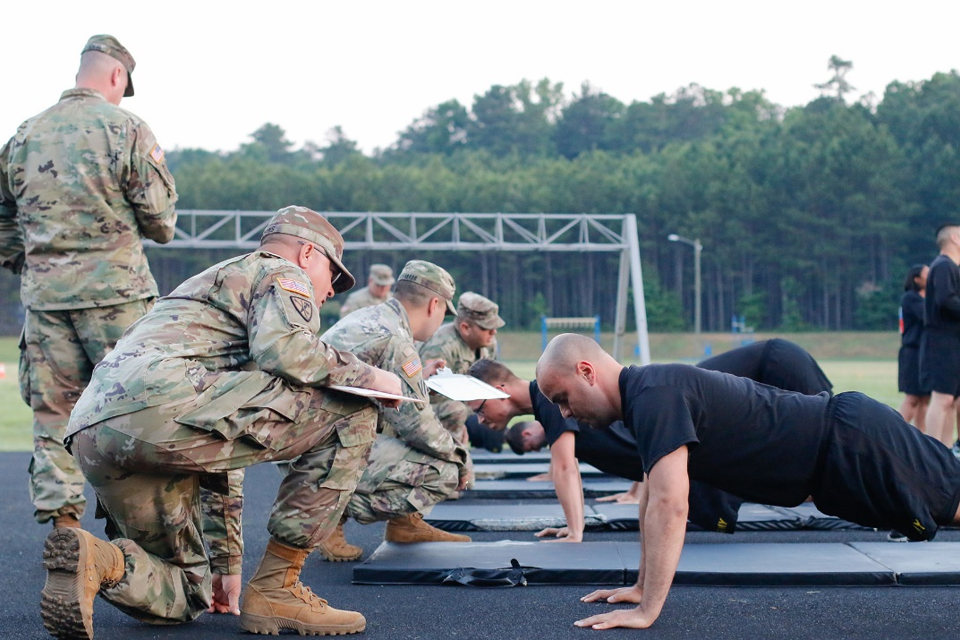
Implementing a System to Improve Military Force Readiness and Decrease Disease Non-Battle Injury through FHIR/API/App System:
By:
Kurt McCarthy

Slide 2
The Current Problem: Disease Non-Battle Injury
Currently, the United States military has participated in multiple oppositions to combat the Global War on Terror (GWOT), to make things more intricate, geopolitics have become very abrasive between the U.S, NATO, Russia, and Chinese forces.
This means that there will be a direct correlation to an influx of service members ending up with disability in the future.
However, the statistic remains that only a small percentage of service members see combat.
Therefore, there must be other independent variables that are causing the large percentage of Disease Non-Battle Injurie (DNBI) rates that have been plaguing force medical and mental readiness.

Slide 3
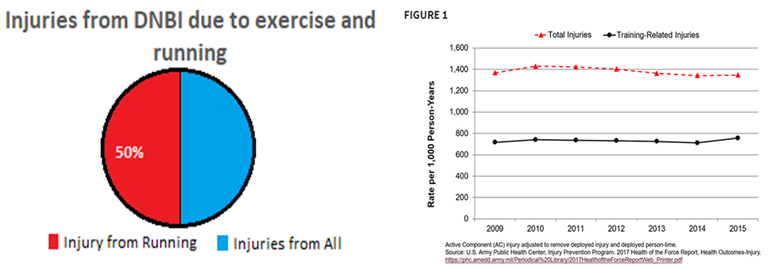
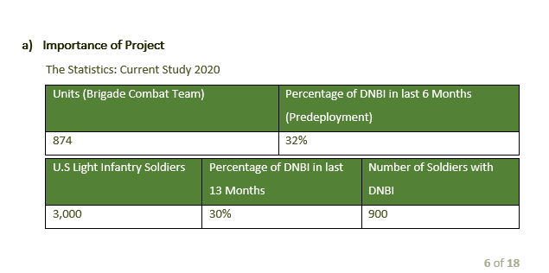
Disease Non-Battle Injury Study 2020
Musculoskeletal Injuries and United States Army Readiness Part I: Overview of Injuries and their Strategic Impact | Military Medicine | Oxford Academic (oup.com)

Slide 4
The Systems at Play
Advana: The new advanced data analytics platform created by Booze Allen Hamilton that the Department of Defense (DOD) uses to store data to include health data.
MHS GENESIS: The new Electronic Health Record (EHR) that stores both veteran and active-duty members health data that is logged.

Slide 5
The Issue with the Current Systems & Targeted Users
Analysis identified the lack of communication/interoperability between service members EHRs and those making health related policies, the unit commanders that are training service members, and the physicians logging information into the EHR of the service member.
Unit Commanders need this medical data to make informed decisions to decrease DNBI within their unit to improve medical readiness and to take the burden of injury off of the service member.
This is the main argument to bring interoperability and FHIR standards to commanders at the unit level.

Slide 6
The Fix to the Problem
I propose that the DoD implement an API that pulls data from Advana which gets its information from MHS GENISIS the HER system.
This API will sync with an application that conducts data analysis from the HER, utilizing FHIR standards for each commander’s battalion/company and present the data in a dashboard that can give the commander an overall look at what is negatively affecting their unit’s medical readiness and causing DNBI (example next slide).

Slide 7
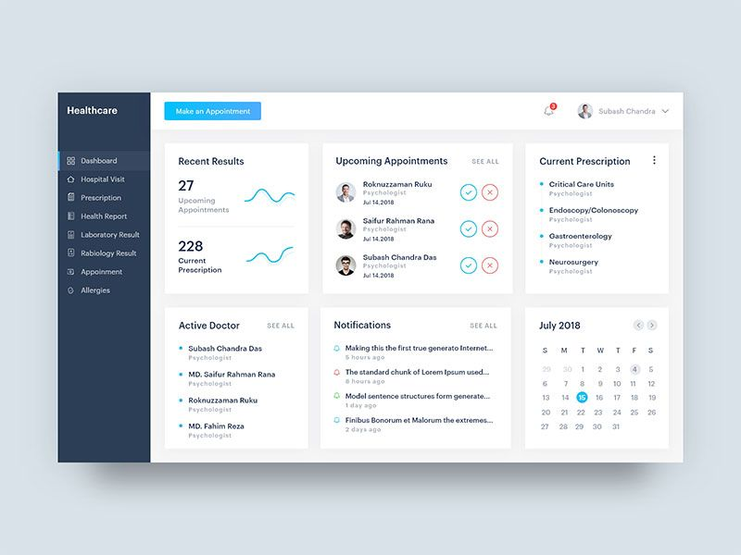
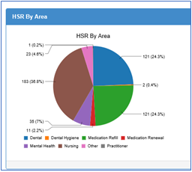
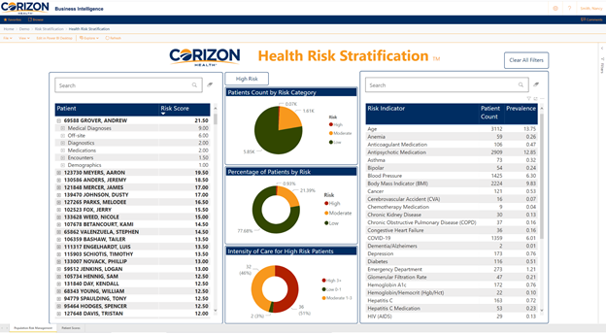
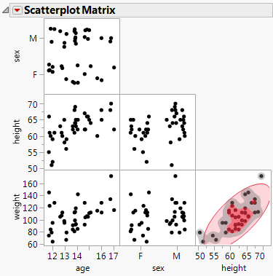
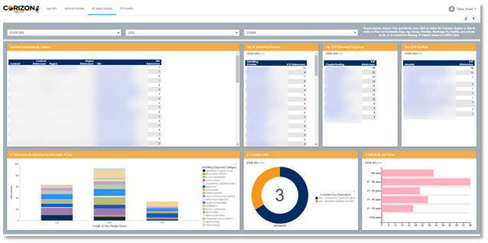
Dashboard Example
Injury Report by Area
Medical Readiness Dashboard

Slide 8
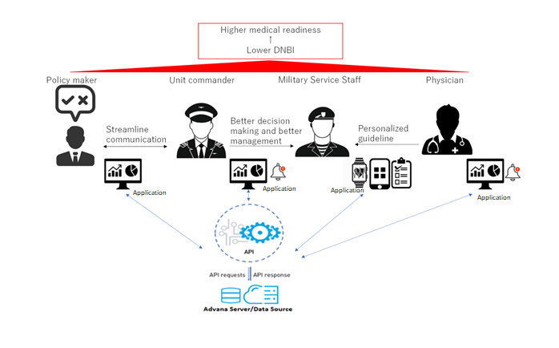
Structure of the FHIR API/Application

Slide 9
FHIR Standards to be Implemented
Condition: This way machine learning (ML) and artificial intelligence (AI) through the data analysis application can evaluate through code by searching the “Condition”, what injuries were accounted for, i.e., when the injury took place, what part of the body was injured, and why the injury occurred. According to the HL7 FHIR website.
Diagnostic_Report: Logged when a practitioner, "requests" a set of "tests", the diagnostic service returns a "report" which may contain a "narrative" - a written summary of the outcomes, and/or "results" - the individual pieces of atomic data which each are "observations
Clinical_Impression: Servicing physician recommends a treatment plan for the injury. This is important for Commanders to be tracking to ensure that their service member gets healed and back to being mission capable.
DiagnosticReport - FHIR v4.0.1 (hl7.org)

Slide 10
Example of how ML & AI Working (FHIR)
AI and ML coded to recognize specific key words will then document those key words into data streams.
For example, if a report reads, “service member fractured left tibia bone at Fort Benning, GA, running on hard concreate surface during physical training”.
The analytical application using ML would recognize an injury of the tibia due to running on concreate (solid surface).
Which would indicate that the unit may want to conduct minimal impact exercises or invest in better running surfaces to prevent an influx of musculoskeletal injuries.

Slide 11
The End Thank You!

